Slide 1
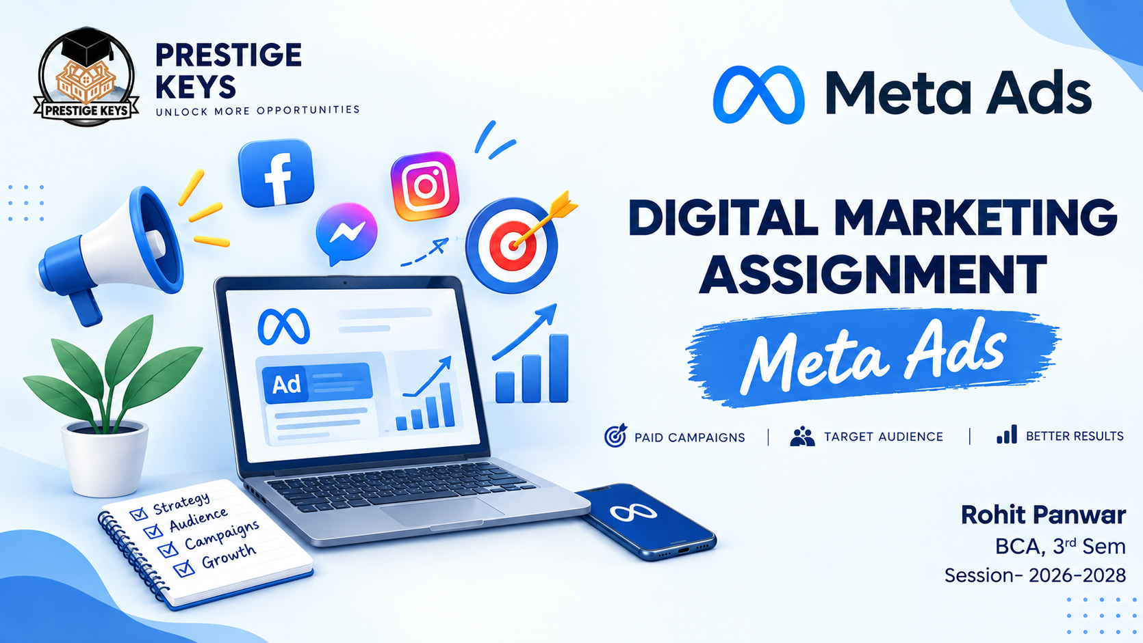

Slide 2

Digital Marketing
Assignment Report
ASSIGNMENT FOLIO
Assignment Folio of
Digital Marketing
Submitted to
Dezyne École College
Toward Digital Marketing
By
Rohit Panwar
BCA
Sem III
Dezyne École College
106/10, Civil Lines, Ajmer
www.dezyneecole.com

Slide 3
Digital Marketing
Acknowledgement
ASSIGNMENT FOLIO
We take this opportunity to express our sincere gratitude to Dezyne École College for providing us with the knowledge, resources, and guidance essential to the successful completion of this project.
Our deepest thanks to our respected Principal, Dr. Vinita Mathur, for her visionary leadership and continuous encouragement. Her commitment to academic excellence and student growth has been a constant source of motivation and pride.
We are equally thankful to all our faculty members for their consistent support, expert advice, and valuable insights that shaped our learning and helped us achieve this milestone.
Lastly, we extend heartfelt thanks to everyone who directly or indirectly contributed to the success of this project.
We are proud to be part of Dezyne École College, an institution that truly nurtures professionalism, innovation, and purpose.
With sincere appreciation,
Rohit Panwar
Department of Bachelor of Computer Applications
Dezyne École College, Ajmer

Slide 4
Case Study
Digital Marketing
ASSIGNMENT FOLIO
Objectives :
Increase Instagram Profile Visits, Boost Brand Awareness, Grow Followers Organically, Increase Engagement Rate & Improve Content Reach.
Key Feature :
Traffic Campaign Objective
Selected the "Traffic" objective in Meta Ads Manager to drive Instagram profile visits.
2. Audience Targeting
Targeted users based on age, interests, behavior, and location.
3. Engaging Creative Content
Used eye-catching Reels, carousel posts, and strong captions.
4. Call-to-Action Button
Used "Visit Instagram Profile" to direct users instantly.
5. Performance Tracking
Monitored metrics like CTR, Profile Visits, CPC, and Engagement Rate.

Slide 5


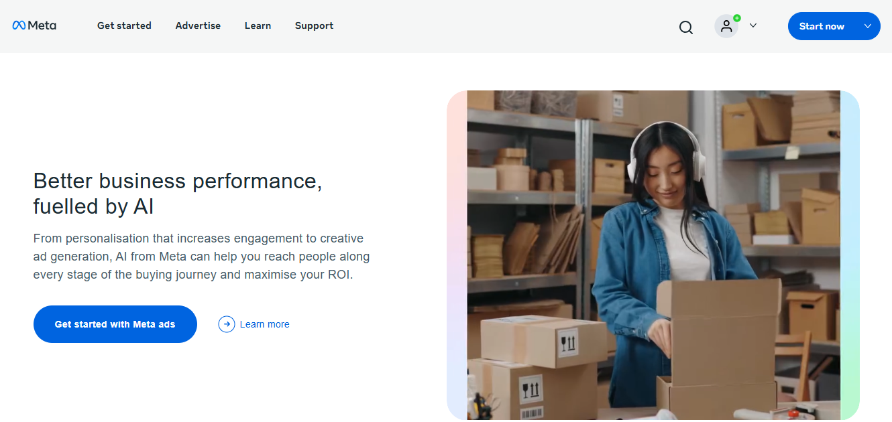
Meta Ads Platform - Overview

Slide 6
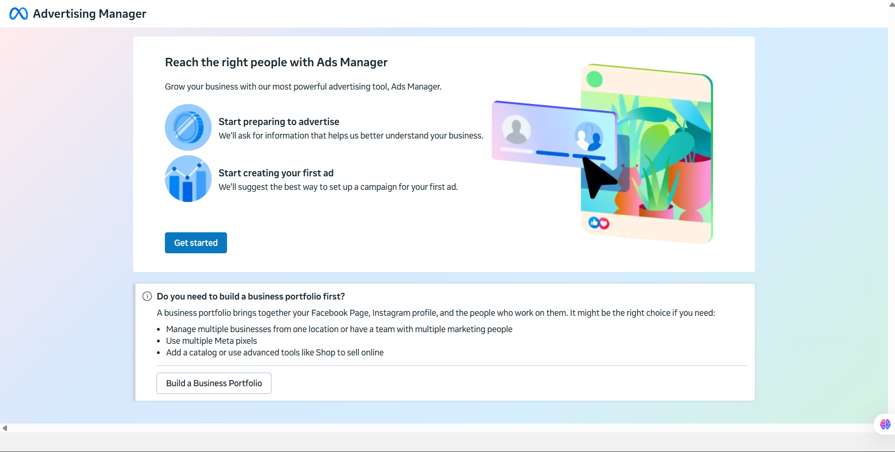
Reach the Right People

Slide 7
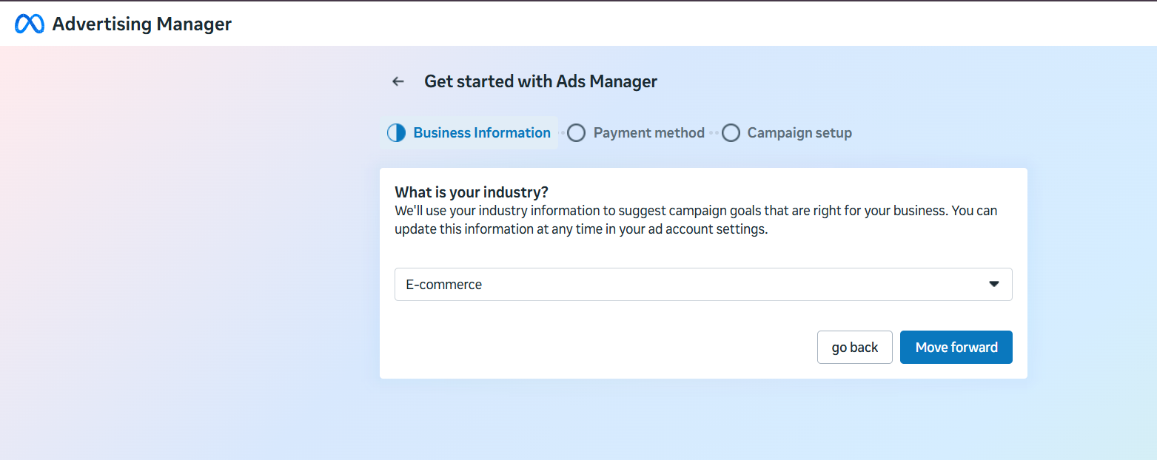
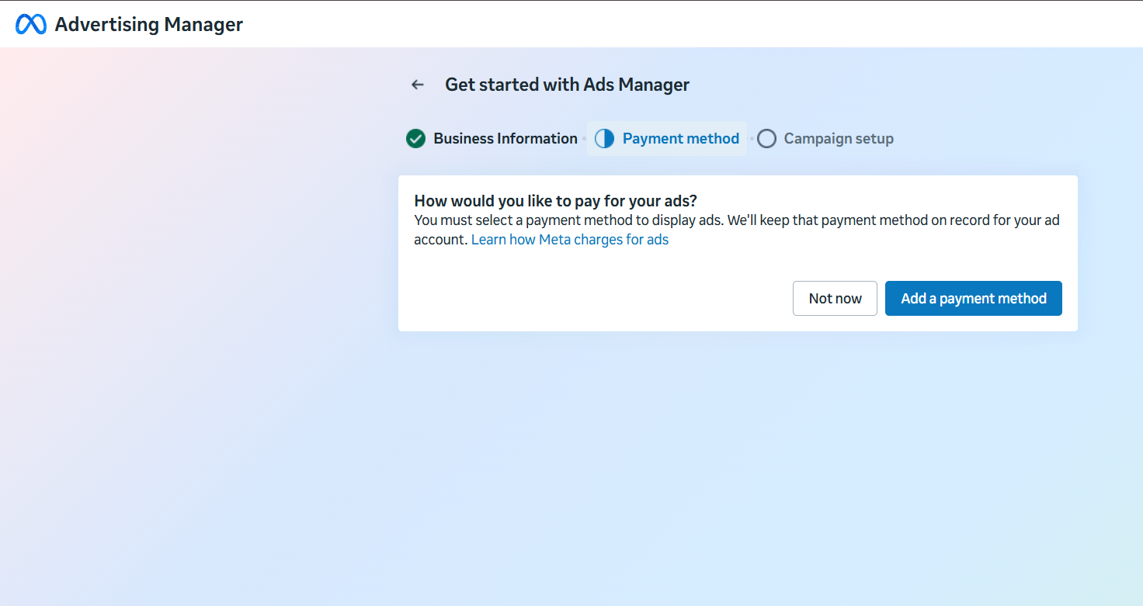
Get Started with Ads Manager

Slide 8
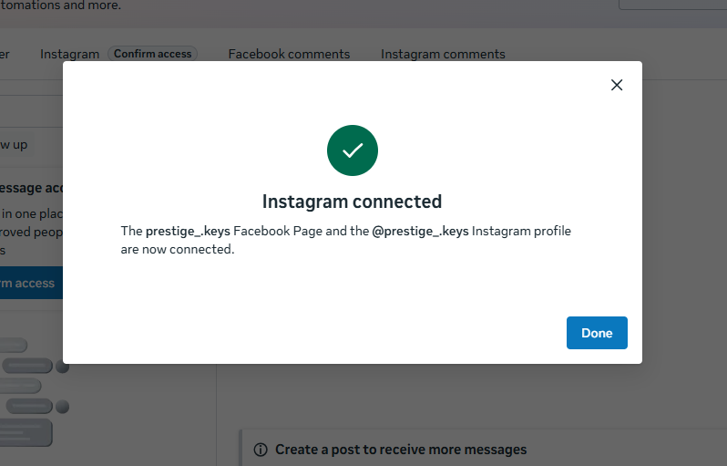
Connected Instagram

Slide 9
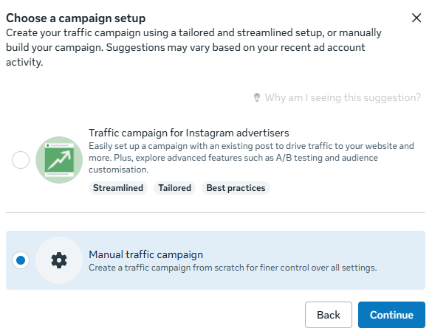
Campaign Setup – Manual Traffic Campaign

Slide 10
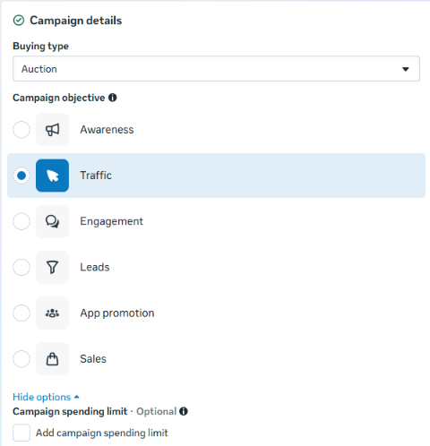
Campaign Objective Selection – Online Traffic

Slide 11
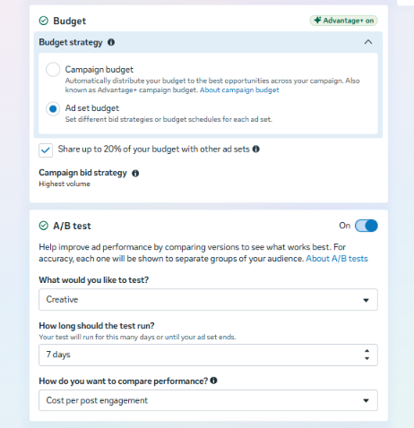
Budget Strategy & Bidding Selection

Slide 12
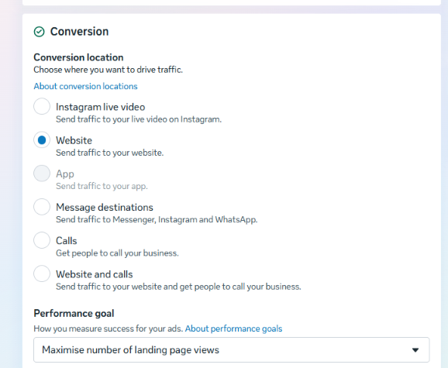
Ad Set Configuration – Profile Traffic Strategy

Slide 13
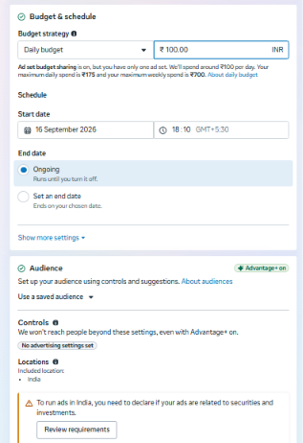
Budget Strategy & Bidding Selection

Slide 14

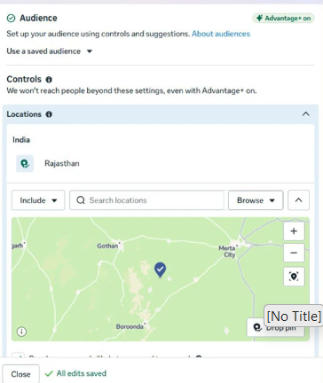
Location Targeting

Slide 15
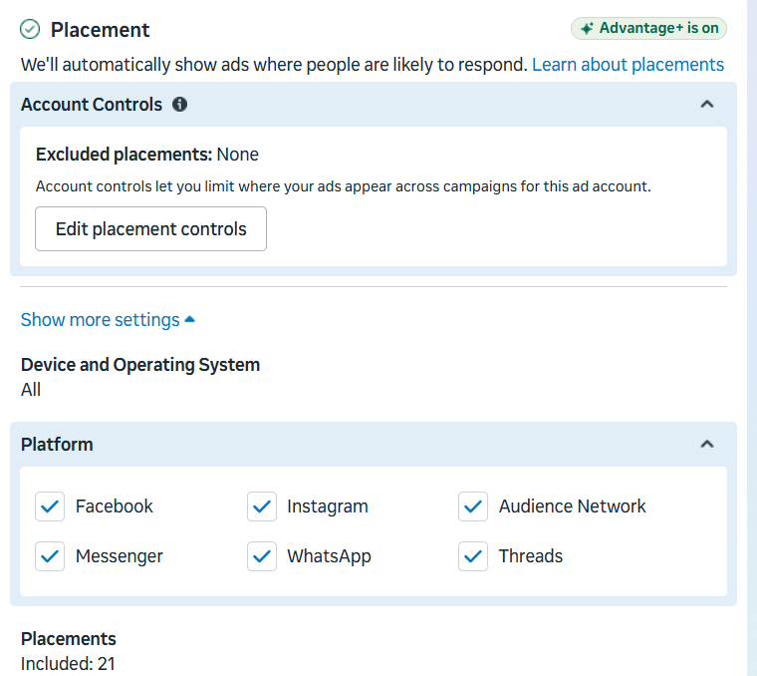
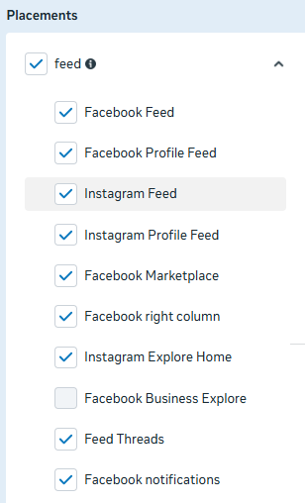
Ad Placement Strategy

Slide 16
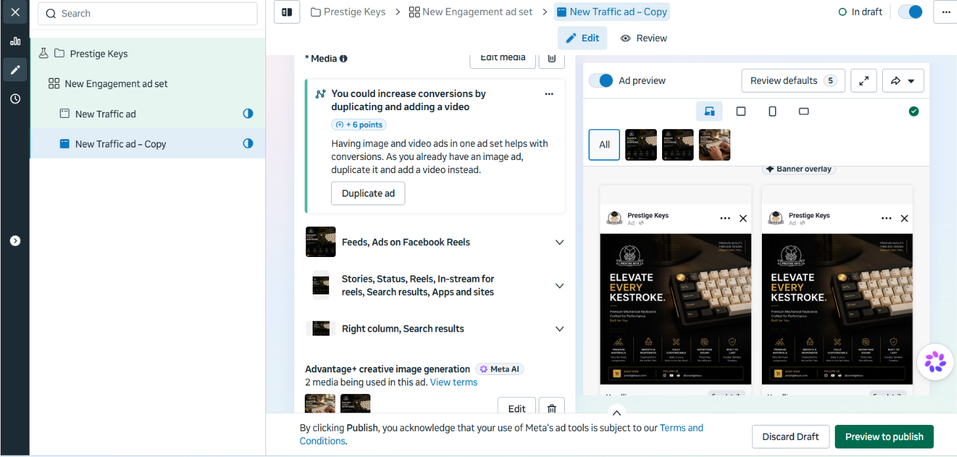
Ad Campaign Setup

Slide 17


